Slide 1

Exam Management System

Slide 2
motivation
With the increase in the size of the student body, it has become difficult to manage grading within the given time constraints. This has led many courses to adopt a multiple-choice format, which is faster to grade, and easier to analyze.
The creation of one-time-use questions is costly and unsustainable- We want to ease the process of creating those exams.
The creation of challenging multiple-choice questions is not a trivial task.

Slide 3
The solution
A web-based System for managing the course growing pool of questions.
help you manage creating future questions
1
analyze the questions quality
2
create an exam based on analysis of the questions
3

Slide 4


Slide 5
roles
System Administrator:
Create courses
Delete courses
Can view the GPA of the courses
Course Administrator:
Assign course staff
Define the course’s exam parameters
Generates exams
TA:
creation and validation of questions, stems, keys, distractors, and solutions.
Grader:
Add a student solution to an existing exam.

Slide 6
Current System

Slide 7
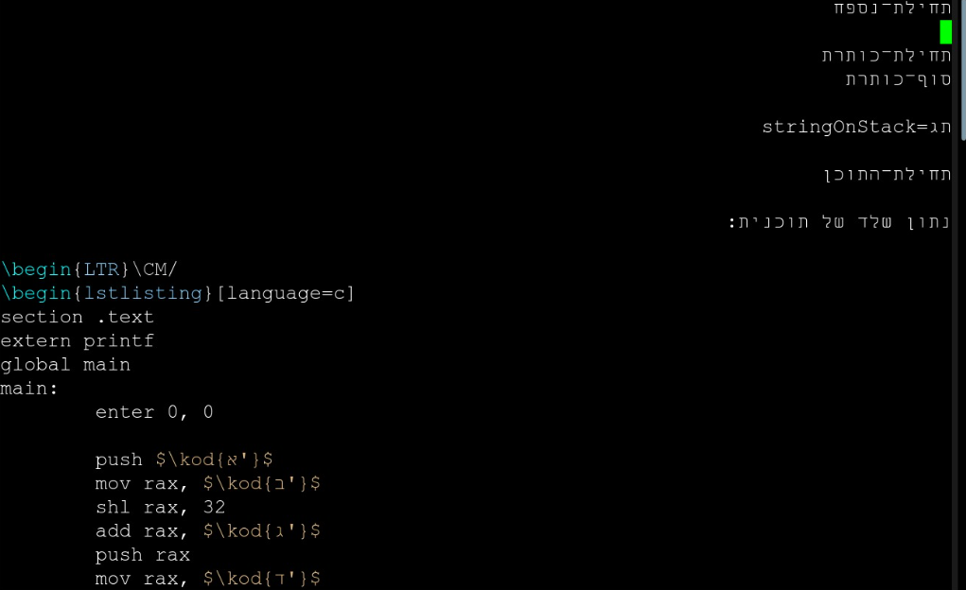
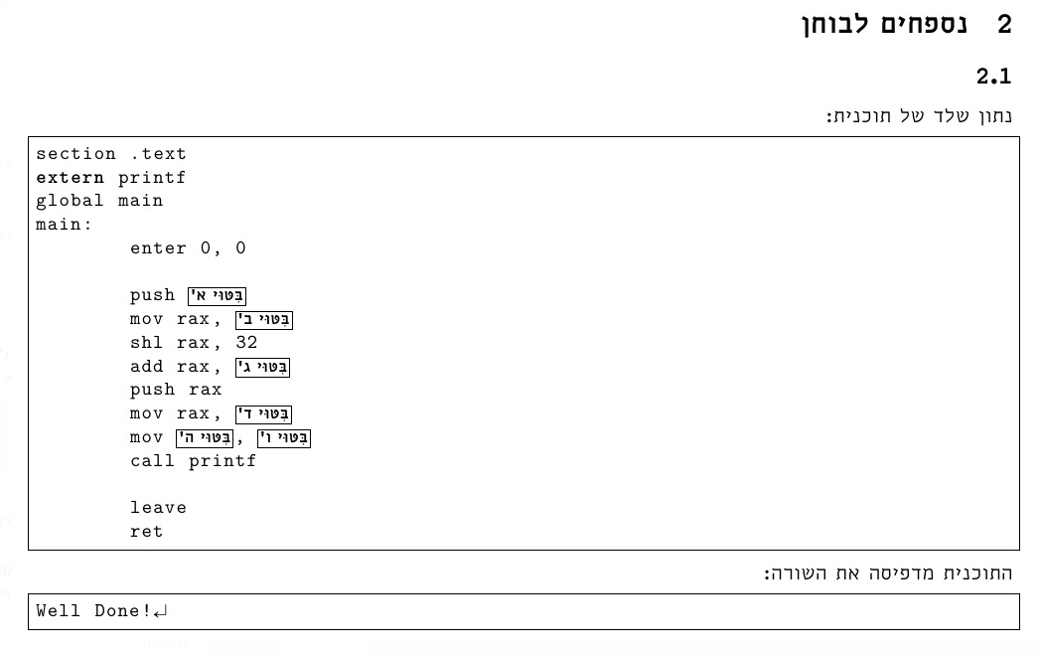
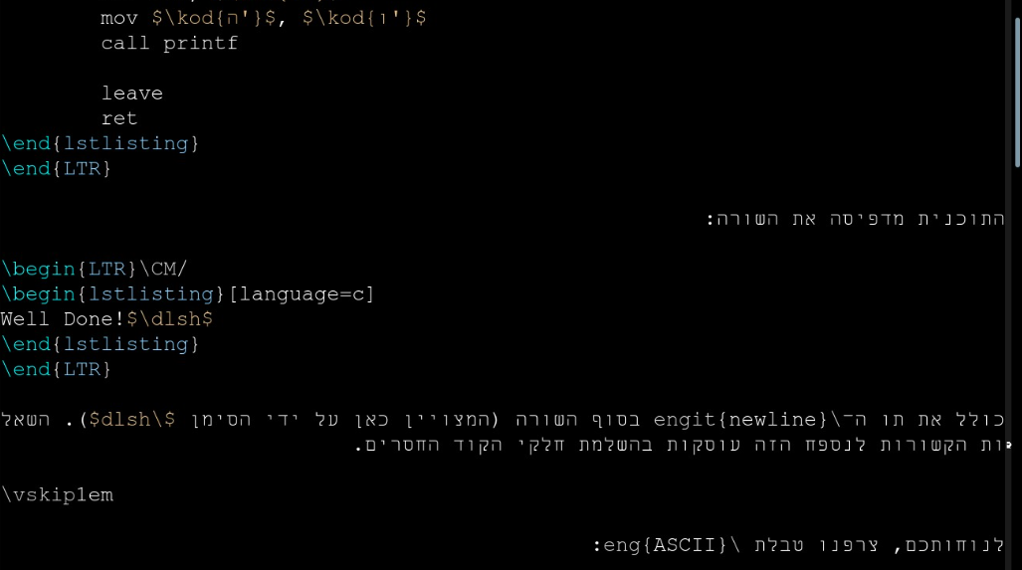
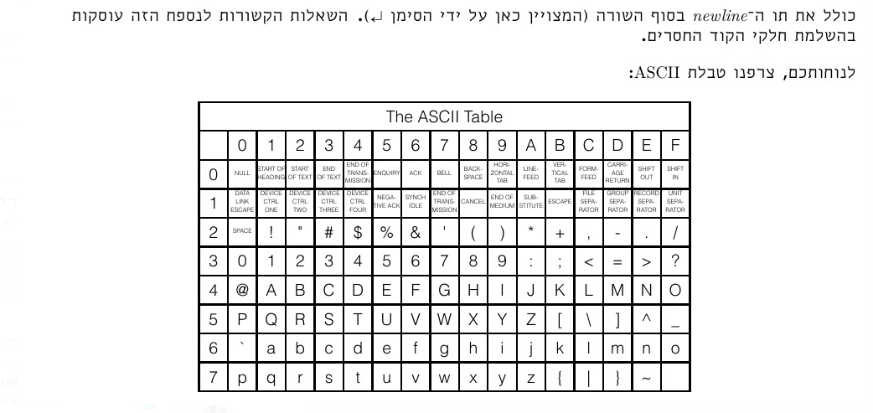
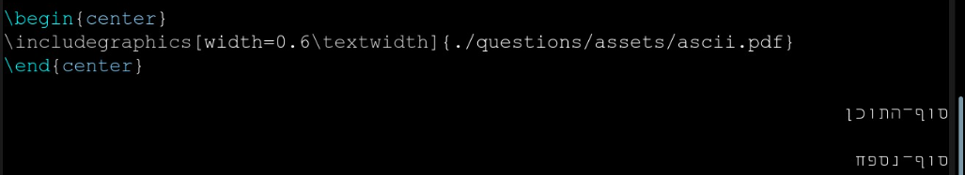

Slide 8
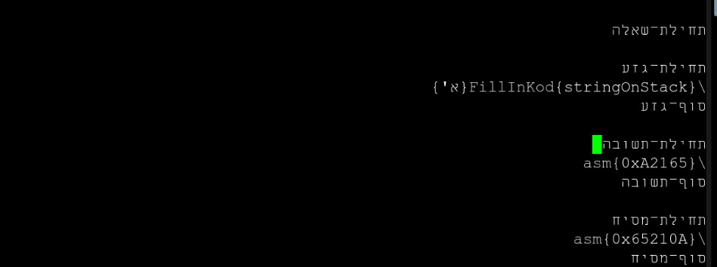
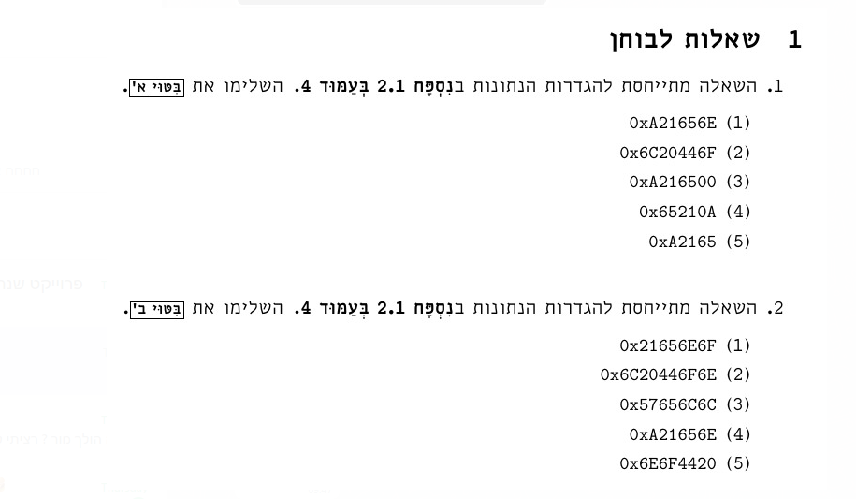
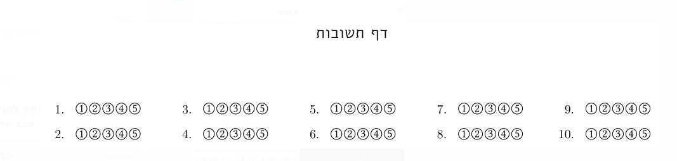
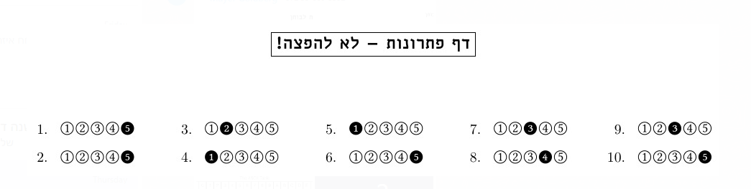
…

Slide 9
Solution Mockup

Slide 10
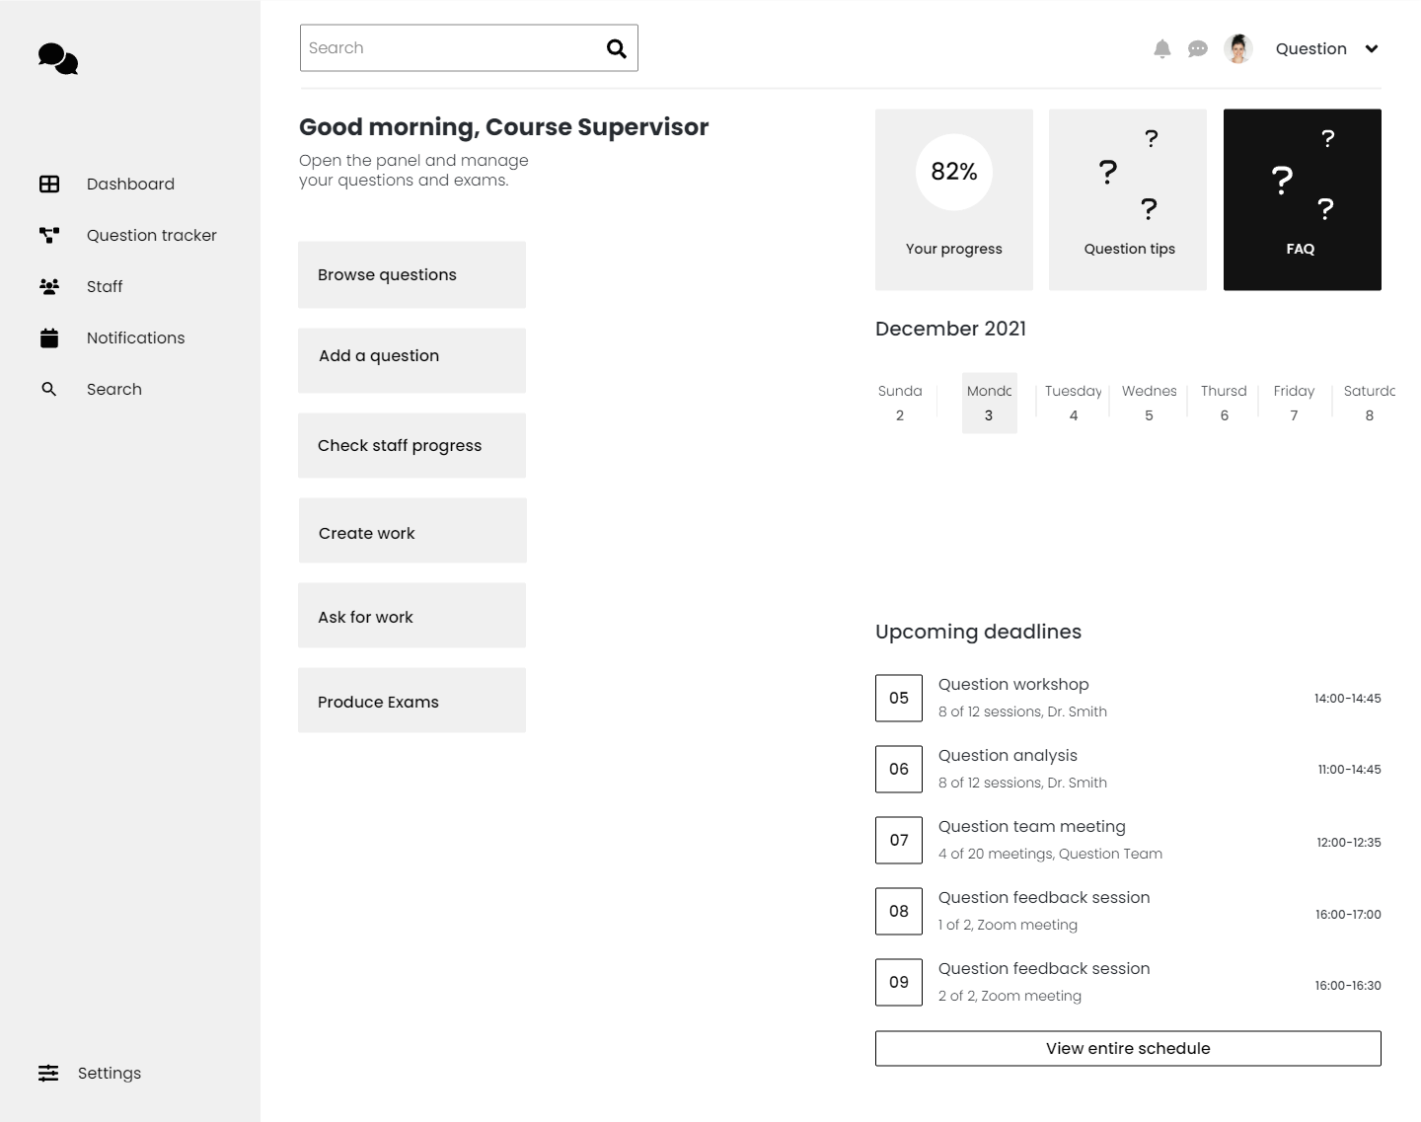
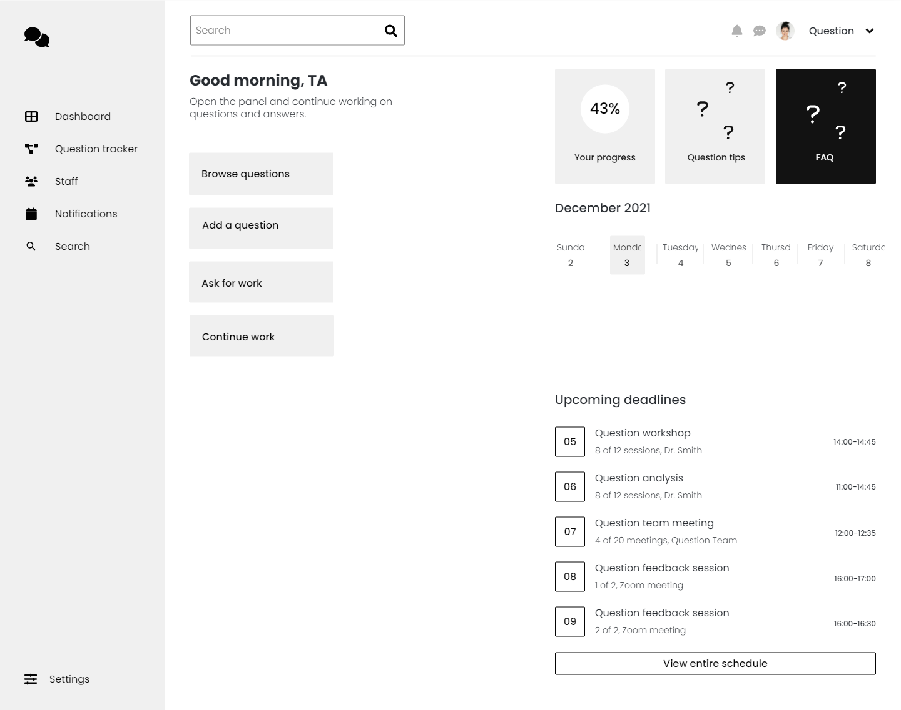

Slide 11
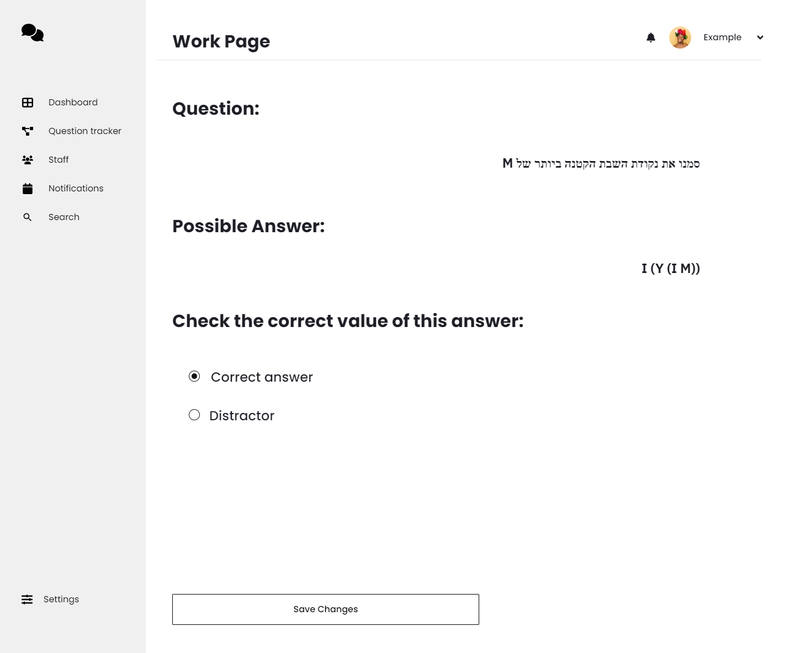

Slide 12
Risks
User Adoption Challenges:
Example: Resistance from users to adapt to the new system.
Mitigation: Provide user documentation, and gather feedback early in the development process.
Data Security:
Example: Vulnerability to unauthorized access and leaking of sensitive information.
Mitigation: Use user authentication mechanisms to safeguard sensitive data, access will be allowed only from the university network, or by using vpn.
Web Interface:
None of the members had work as a web developmet
Mitigation: All members will read and study about prepared libraries (specifically risk) that will allow easy web interface development

Slide 13
Proof Of Concept

Slide 14
Research:
Examination of Web-Based Workflow Tools:
Investigate popular web-based workflow management tools.
Assess their capabilities for role-based dashboards and task distribution.
Algorithmic Task Distribution:
Research and develop a preliminary algorithm for task distribution

Slide 15
Preliminary:
Selection of Web-Based Framework:
Based on research, choose a web-based framework suitable for developing the workflow management system.
Basic UI Development:
Implement basic UI features, such as role-based dashboards and content organization.
Integrate a simple manual task assignment mechanism.

Slide 16
System Implementation:
Workflow management:
Implement a simplified version of the workflow management system
LaTeX-Based Exam Creation and analysis :
Develop a module for flexible LaTeX-based exam, key, and solution creation.
Database Integration:
Establish basic database integration for handling workflow and content data.

Slide 17
Gantt

Slide 18
Example of how it looks

